Slide 1
JORDAN BANK KINDERGARTEN CENTER
IN THE
OXFORD AREA SCHOOL DISTRICT
2023-2024 QUESTION AND ANSWER SESSION

Slide 2
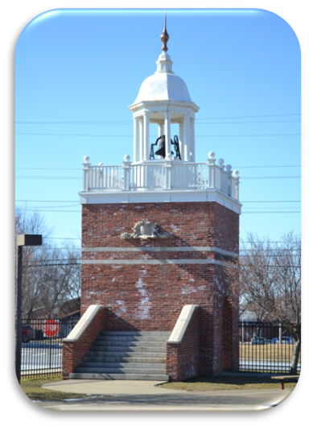
Dr. David Hamburg, Principal
Mrs. Ellen McGinley, Administrative Assistant
Miss Lori Saporosa, School Counselor, MTSS Coordinator
Mrs. Lisa Megonigal, District Registrar
The mission of the Oxford Area School District is to have all students achieve academic excellence in a safe and nurturing environment. In partnership with families and the community, we will prepare each student to be a confident, contributing, productive and responsible citizen.

Slide 3
https://online.fliphtml5.com/udnau/wway/

Slide 4
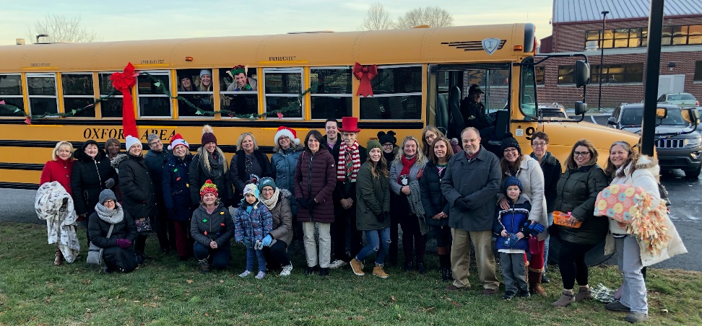
10 sections of full day kindergarten (8:40 am – 3:10 pm)
1 teacher and 1 aide per class
Multi-tiered System of Support (MTSS)
3 Special Education teachers-
1 learning support teacher
1 diagnostic kindergarten teacher
1 emotional support teacher
1 Speech and Language Pathologist
1 ELL specialist
2 Reading specialists
1 Counselor

Slide 5
The Kindergarten program focuses on:
•Language Development – Pearson Reading Street
•Basic math skills development – Math in Focus
•Promoting an appreciation for diversity and history – SAVVAS: My World Interactive
•Incorporating active learning – Science Fusion
•Providing opportunities for investigation, exploration, and discovery
•Encouraging a positive self-concept
•Promoting creative expression
•Fostering positive interaction with others
•Developing quality work habits and school routines

Slide 6
Art – Ms. Viviana Diaz-Perez
Library/Media – Mrs. Kim Lewin
Music – Mrs. Deb McCaskey
Health/Physical Education – Mrs.Mollie Steigerwalt

Slide 7
School Resource Officer
Camera system throughout
Secure walkie talkie system
Telephones in each classroom
Safety and Security Plan inclusive of drills
Visitors-Must check in first at main office
Volunteers-Must check in at main office
Clearances

Slide 8
Home and school communication
School website (https://www.oxfordasd.org/Domain/8)
BEE books
Parent Universities
Conferences
E-mail
Telephone
Sunday evening automated calls and email
Twitter and Instagram: Dr. Hamburg@JB_OASD
Keep in Touch

Slide 9
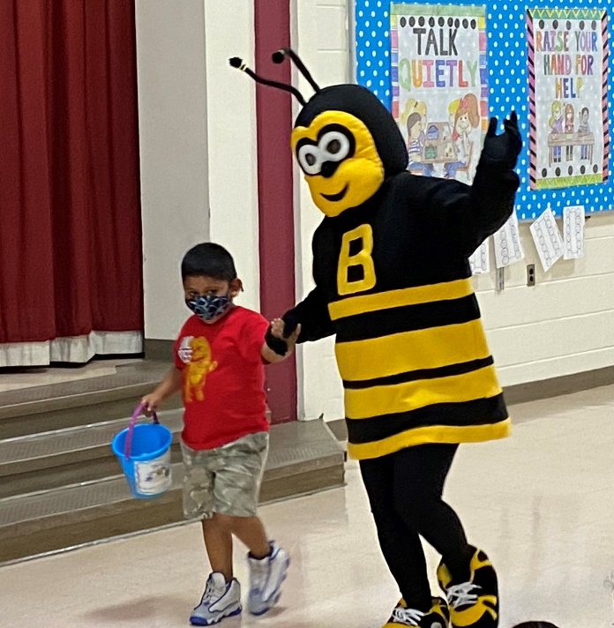
School-Wide Positive Behavior
Encouraging Children to make good personal decisions
through teaching the following valued character qualities:
Responsibility
Respect
Honesty
Kind
Giving Effort

